Slide 1
Learning Session 1 Overview of ‘D’(define) from the D-M-A-I-C Model

Slide 2
The presence of the Laboratory African Regional Collaboration (LARC) logo on slides
indicates that content (in whole or in part) originates with the LARC Program

Slide 3
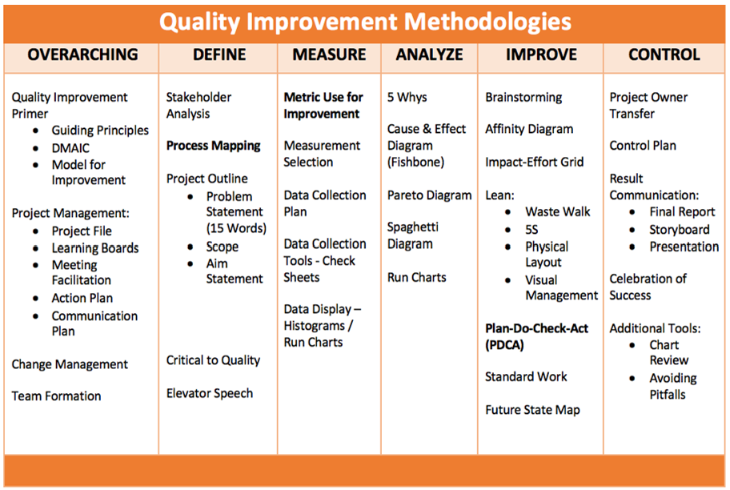
LARC Workbook

Slide 4
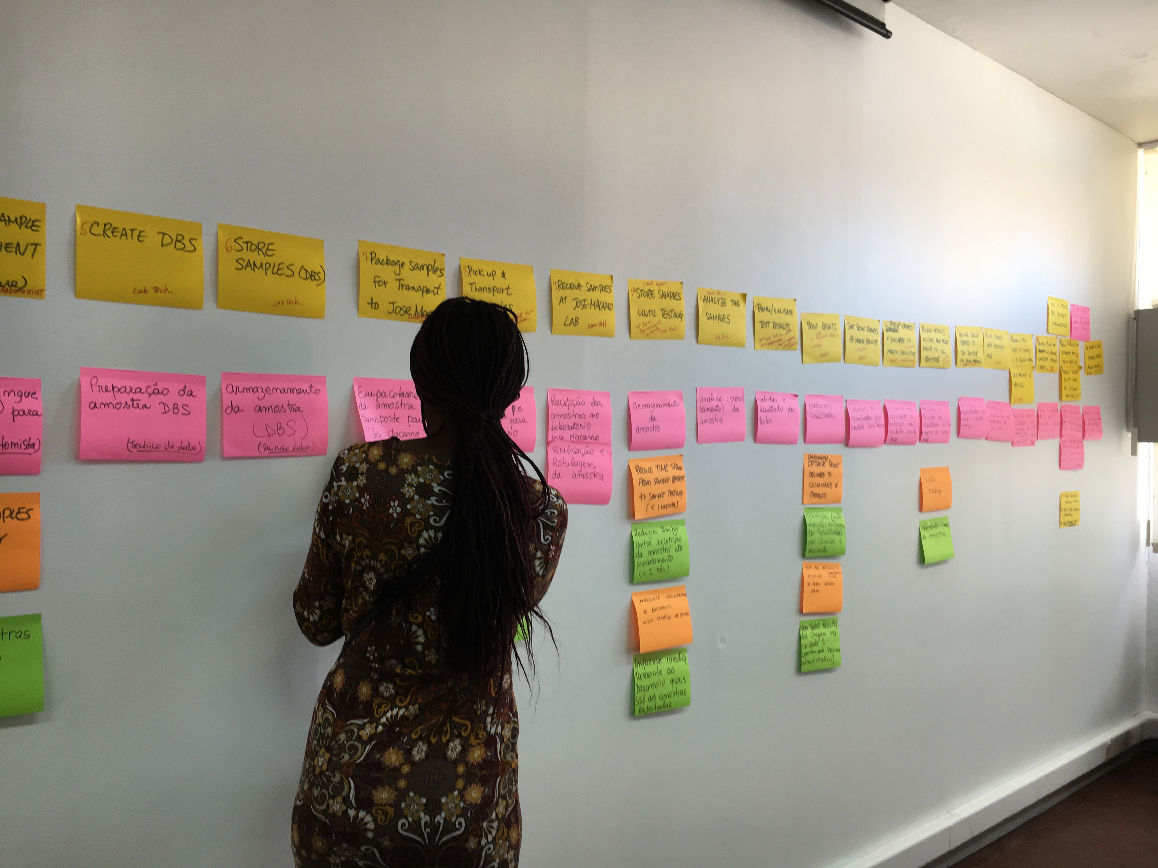
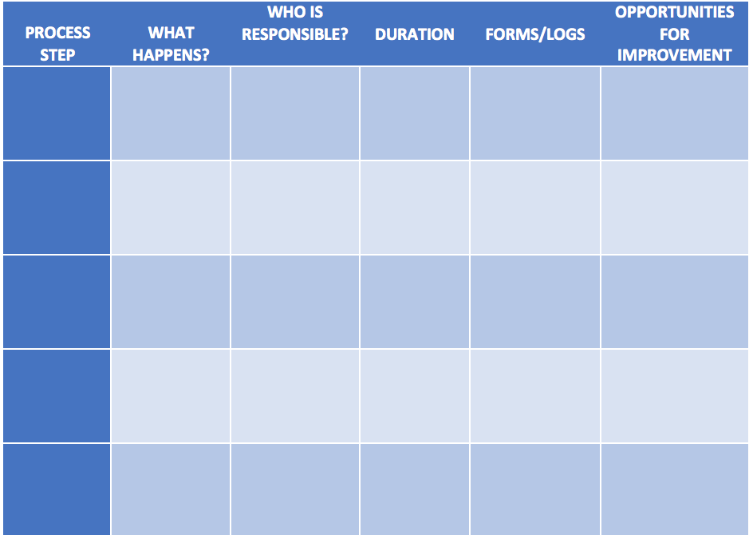
Process Mapping
LARC Workbook, p. 38-41
https://www.larccqi.org/uploads/resources/LARC-3.0-WORKBOOK.pdf
LARC Workbook

Slide 5
Guiding Principles for Quality Improvement
Focus on the needs of the USERS
Focus on PROCESSES to increase the productivity of work
Use DATA to improve services
Use TEAMS to improve quality
Improve COMMUNICATION
LARC Workbook

Slide 6
Process = A series of actions or steps taken in order to achieve a particular end
LARC Workbook

Slide 7
Process = Sequence of procedures to convert inputs into outputs
INPUTS
Input #1
Input #2
Input #3
Process Step
A
Process Step
B
OUTPUT
Process Step
C
LARC Workbook

Slide 8
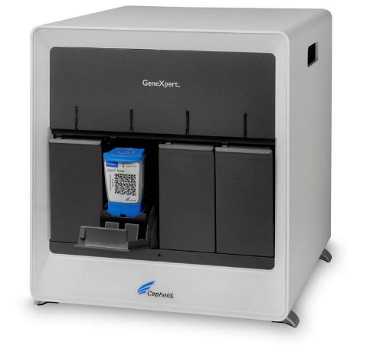
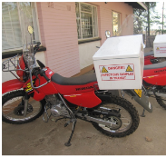
TB DIAGNOSTIC CASCADE
Result Transmission & Interpretation by Clinician
Symptom Identification
Specimen Collection & Processing
Specimen Transport
Laboratory Testing
Treatment Initiation
LARC Workbook

Slide 9
"Draw a flowchart (process map) for whatever you are doing. Until you do, you do not fully understand what you are doing. You just have a job.”
- W Edwards Deming (1900-1993)
LARC Workbook

Slide 10
Why are Processes Important?
They impact the way we do our work!
INTERDEPENDENCE
SEE
See how components depend on each other
Understand / See Process
IMPROVE
Improve Process
LARC Workbook

Slide 11
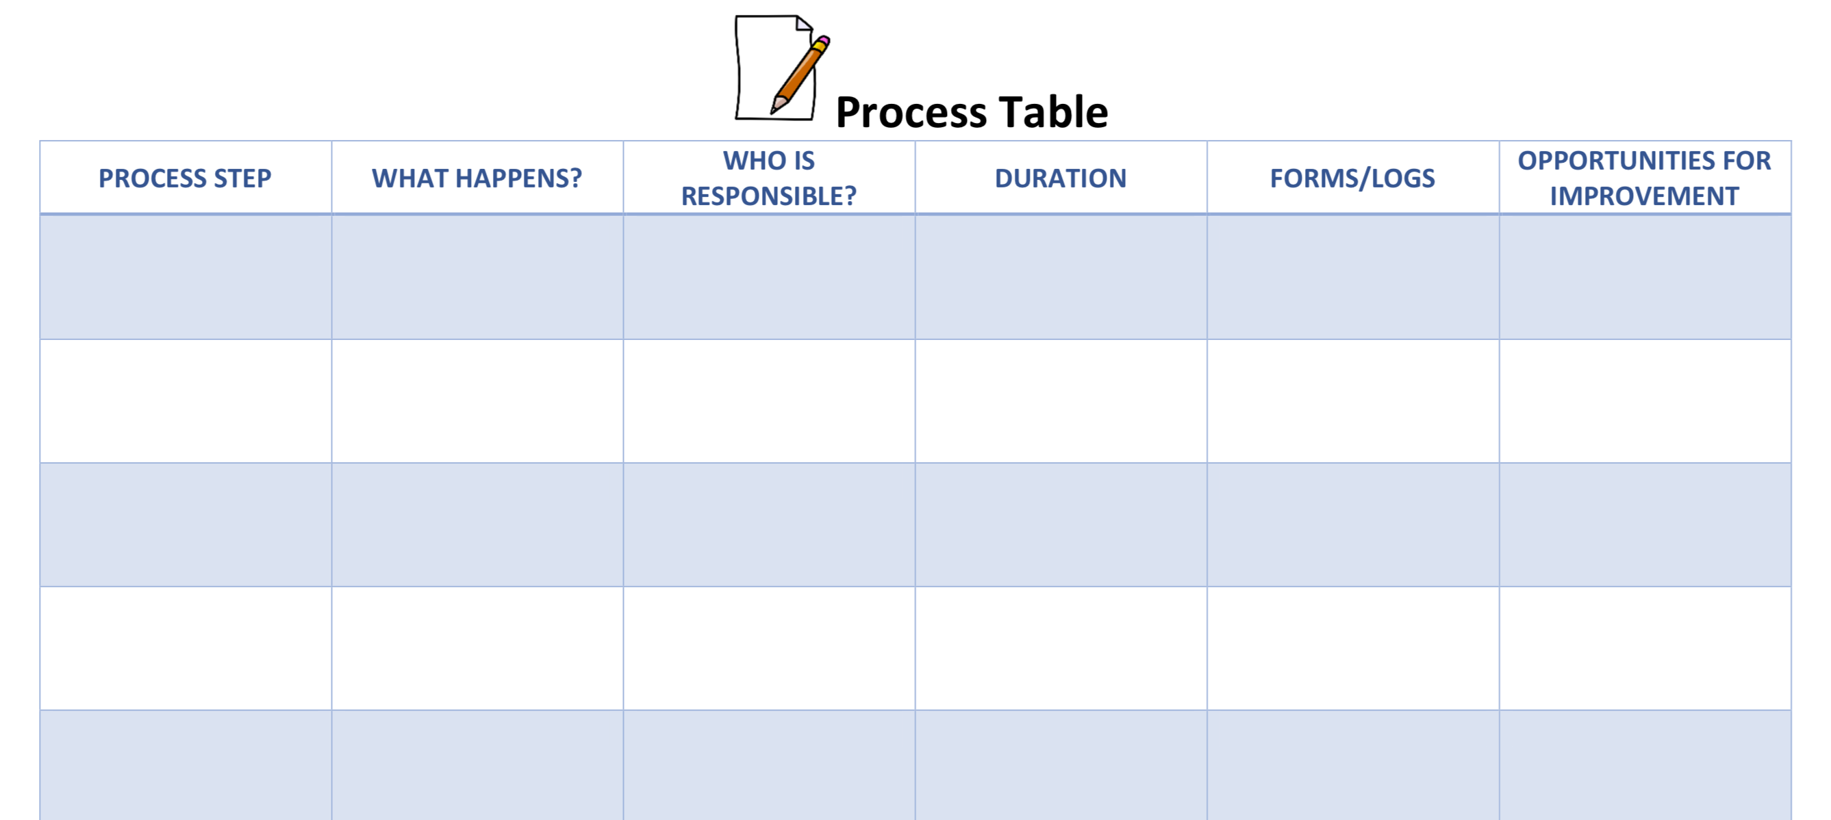
Process Table Template
LARC Workbook

Slide 12
Benefits of Process Mapping
Based on your Smart Start Process Mapping activity, share the benefits for your team.
LARC Workbook
Notes:
This can still come up on the first day of Process mapping

Slide 13
Process + Structure = Outcome
Process
Structure
LARC Workbook

Slide 14
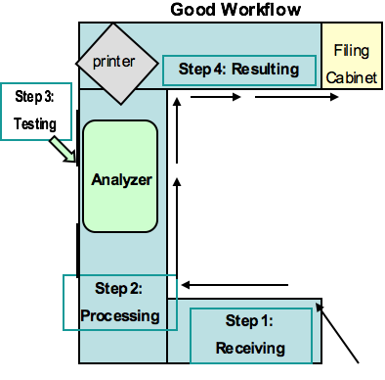
Structure
Physical Structure
Organization / Culture
LARC Workbook

Slide 15
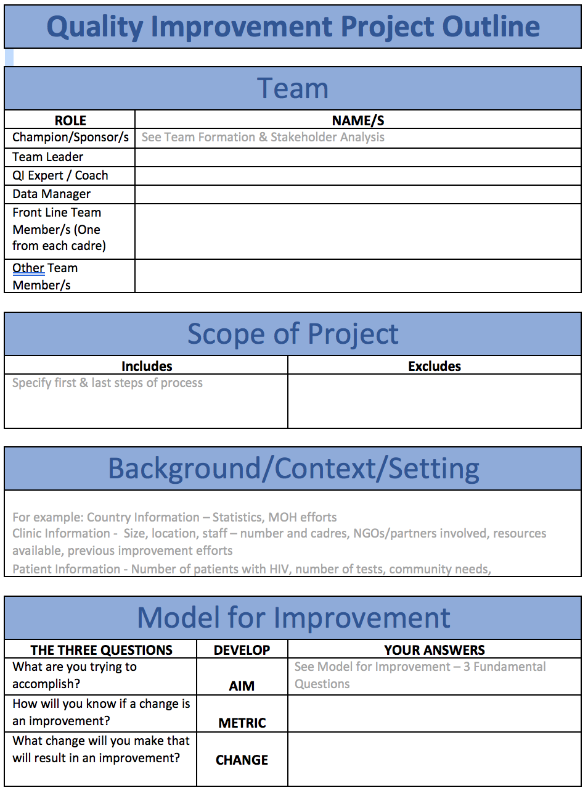
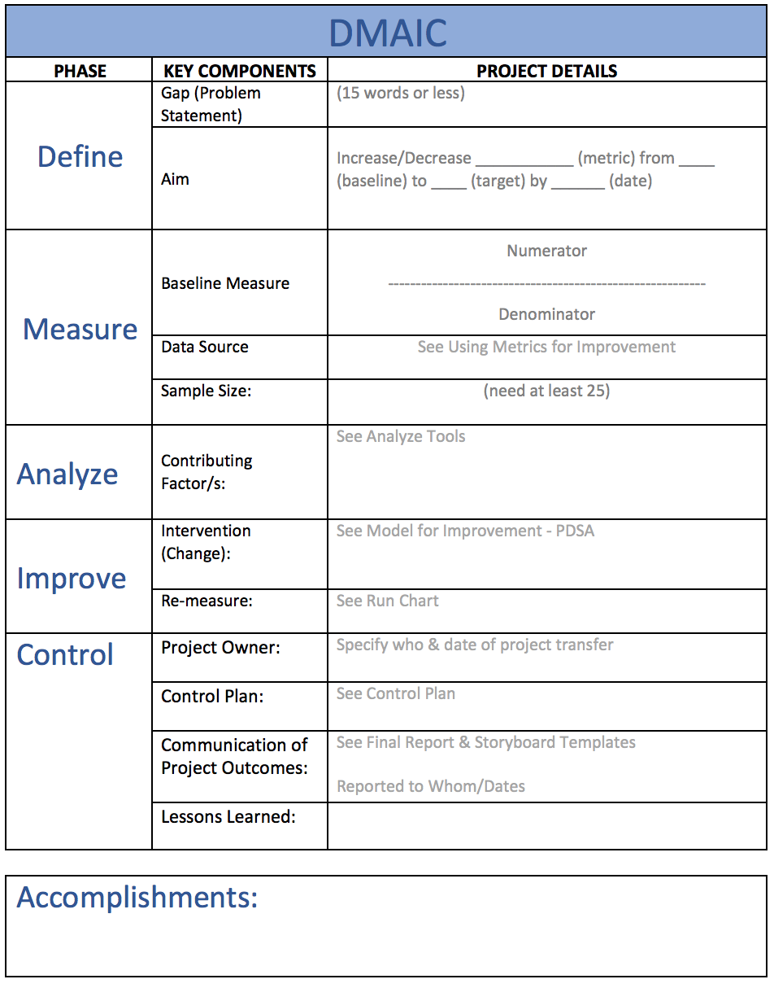
LARC Workbook, p. 13-14
https://www.larccqi.org/uploads/resources/LARC-3.0-WORKBOOK.pdf
LARC Workbook

Slide 16
Elevator Speech
Aim: This project is about _____________________________________________________
Things to achieve: As a result of these efforts, ____________________________________
Rationale/justification: It’s important because we are concerned about::
___________________________________________________________
___________________________________________________________
Indicators: Success will be measured by showing improvement in:
______________________________________________________
______________________________________________________
What we need from you –
_____________________________________________________
LARC Workbook, p. 47
https://www.larccqi.org/uploads/resources/LARC-3.0-WORKBOOK.pdf
LARC Workbook

Slide 17
Questions?

